Slide 1
POSC 3710: European Politics
8/26/2026: How Did Europe Democratize?
Dr. Will Horne
Clemson University

Slide 2
Where We Left Off
Monday was about how to manage markets: abolish them, protect them, or tame them
Any answer assumes somebody gets to decide: an electorate, a parliament, a president
But when Marx wrote in 1848, almost nobody in Europe could vote
When Hayek wrote, Europe was emerging from WWII
Today: How did Europe become a continent of democracies?

Slide 3
Opening Discussion
What has to be true before you would call a country a democracy?
Suppose everyone can vote, but the government does not answer to the people they elect. Is that a democracy?

Slide 4
What Counts as a Democracy?
Where Did Democracy Come From, and Does It Still Work?
CrashCourse Political Theory
▶ Plays 3:13 – 8:27 · about 5 minutes
Click the card to play · fallback: youtube.com/watch?v=qz2-X1LrOPg (start at 3:13, stop at 8:27)

Slide 5
Who could vote in 1912?
Universal male suffrage at 25 for the Reichstag, against about 60% of adult men in Britain
German Empire
~42%
Great Britain
~29%
0
10
20
30
40
50
Share of the adult population entitled to vote (%)
Adults = population aged 21 and over, estimated from the 1910–11 censuses. Voting ages differ: 25 in Germany, 21 in Britain; women could not vote in either country.

Slide 6
Two Questions, Not One
Two ways to think about democracy?
SUFFRAGE
RESPONSIBLE GOVERNMENT
Who is allowed to vote?
Property, income or tax thresholds
Age, sex, residence, military service
Gender or racial equality?
Who does the government answer to?
Can the elected chamber remove the executive?
Who controls the budget, the army, the ministers?
Free Press? Free assembly? Fair treatment of opposition?

Slide 7
How did we get here?
It’s a bit crazy that we have democracy at all!
Why would the elite ever cede power
American Story: Democracy via revolution
Kind of…
Europe is much more complicated
Mostly slow and steady expansion of the franchise

Slide 8
How Did Europe Democratize (1)?
Barrington Moore, Social Origins of Dictatorship and Democracy (1966)
Three routes out of the agrarian world: democracy, fascism, communism
Democracy where a commercial middle class broke the landed aristocracy
Fascism where a weak bourgeoisie allied with coercive landlords

Slide 9
How did Europe Democratize (2)?
Elites facing revolution cannot credibly promise redistribution
A promise made under threat dies once the threat does
Handing over the vote hands over the machinery, so it binds
Boix (2003): capital can leave the country; land cannot
High inequality plus immobile assets is the authoritarian mix

Slide 10
How did Europe Democratize (3)?
Capitalism changes the class structure
It builds an organised working class and weakens landed elites
The bourgeoisie wants protection from arbitrary rule, not inclusion
Przeworski: “the poorer classes fought their way in”
But women’s suffrage, he finds, was granted for partisan advantage

Slide 11
How did Europe Democratize (4)?
Ziblatt asks about the losers, not the winners
Where the old right built a strong party, it could lose and survive
Key point: Losers have to be willing to concede
Where it could not, it reached for the crown, the army, the street
Britain’s Tories a strong political organization
The German Conservatives were captured by the Agrarian League

Slide 12
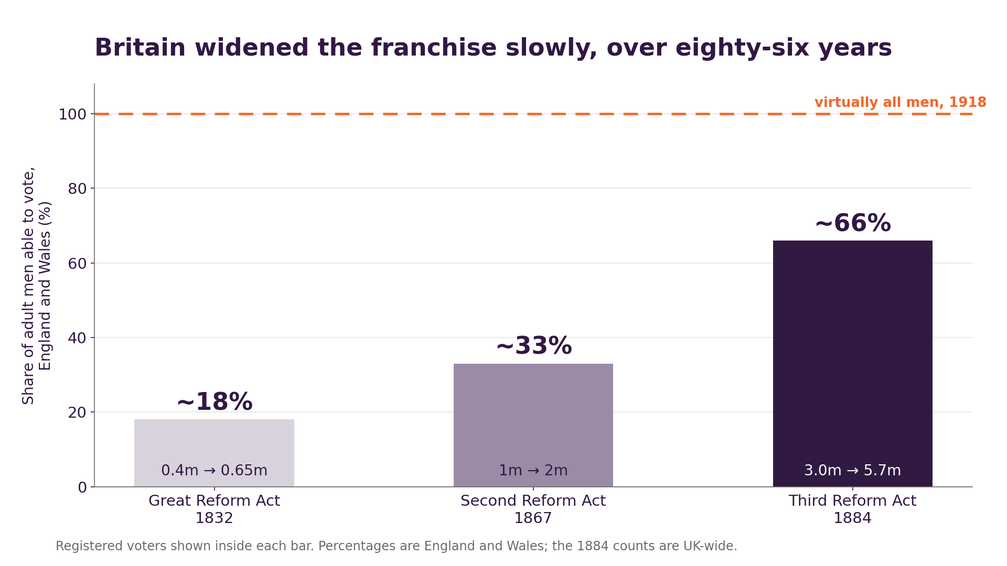
Britain: Eighty-Six Years, Four Acts

Slide 13
Why Britain’s Right Could Live With Democracy
Each step was small enough for the Conservatives to absorb
1867 was carried by the Tories, under Disraeli
The party built professional organization
Losing an election was survivable, so elections were acceptable

Slide 14
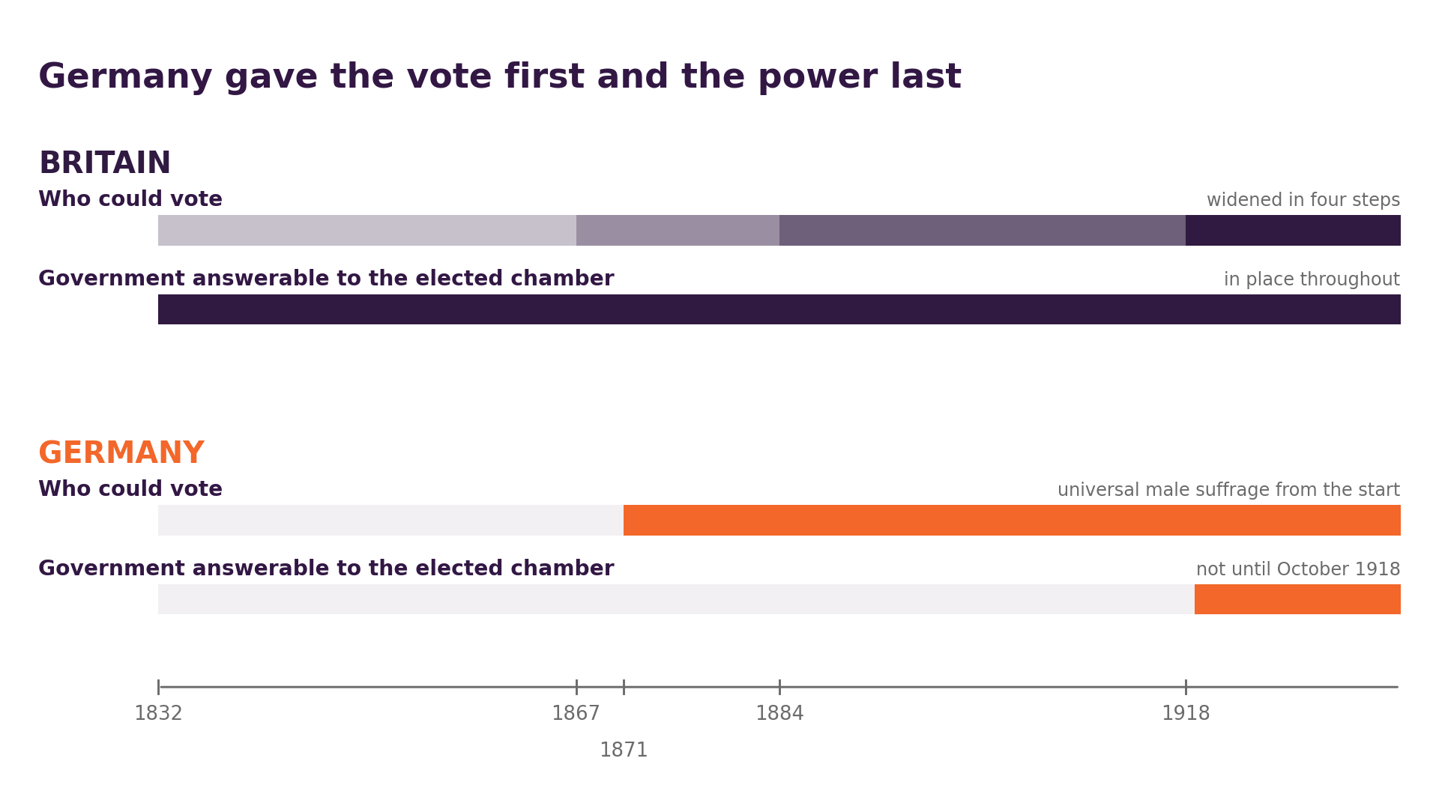
Germany: The Vote Without the Power

Slide 15
A Right That Could Not Win Fair Elections
Same two parties, one year apart, under two sets of rules. Hollow bars: share of votes — solid bars: share of seats.
Reichstag, 1912
Prussian Landtag, 1913
universal male suffrage · secret ballot
three-class franchise · public voting
34.8%
33.6%
27.7%
28.4%
14.8%
10.3%
8.3%
2.3%
Conservatives
SPD
Conservatives
SPD
Seats: 41 and 110 of 397 (Reichstag); 149 and 10 of 443 (Prussia). Prussian shares are primary-elector votes; a first-class vote weighed about ten times a third-class vote.

Slide 16
The Insurance Policy: Prussia’s Three-Class Franchise
The Reichstag had universal male suffrage. Prussia did not
Voters were sorted into three classes by direct tax paid
Each class chose a third of the electors, whatever its size
Voting was indirect, and public — you said your vote out loud
In force 1849–1918, in three fifths of the Empire

Slide 17
What the Insurance Bought
A first-class vote weighed about ten times a third-class vote
In 1908, in 2,214 of Prussia’s 29,028 primary districts, the entire first class was one voter
Prussia was three-fifths of the Empire; its king was the Kaiser, its minister-president usually the Chancellor
In the Bundesrat, Prussia held 17 of 58 votes — and 14 votes blocked any constitutional amendment
A permanent, unilateral veto on reform, held by the people reform would dispossess

Slide 18
What the Insurance Cost
Sheltered by Prussia and the Bundesrat, the Conservatives never built a mass party of their own
The Agrarian League supplied the mass base — then captured the party
It pushed them toward protectionism, militarism, and antisemitism
Britain’s Tories built a machine and could afford to lose; Germany’s right bought insurance and could not
A right that cannot win elections will not support democracy

Slide 19
The Scorecard
Does it explain Britain and Germany?
MOORE
Germany had a large industrial bourgeoisie by 1900, but went fascist. Why?
BOIX; ACEMOGLU
AND ROBINSON
Good on when the vote gets extended, but unclear on backsliding
RUESCHEMEYER ET AL.;
PRZEWORSKI
Germany had Europe’s strongest labour movement. If that were sufficient why did it democratize late?
ZIBLATT
Built to explain exactly this divergence. Does it travel?

Slide 20
What the Review Essay Argues
Ziblatt, World Politics 58:2 (2006): 311–338, on four books
His complaint: “the rich,” “the poor” are too abstract to be actors
Real history has landlords, industrialists, officers, organisers
The models explain arrival far better than survival
Democracy’s first wave was “neither exceptional nor inevitable”

Slide 21
1918–19: Both Arrive, One Survives
Britain 1918: virtually all men at 21, women at 30 — 78% of adults
Britain 1928: women at 21, on the same terms as men
Germany, October 1918: the Chancellor answers to the Reichstag
Germany 1919: men and women at 20, PR, an elected president
On paper, Weimar was the more democratic of the two

Slide 22
Discussion
Germany had the wider franchise and the stronger Labour movement. Why was that not enough?
Ziblatt says look at the right. Does that argument travel to the present?
Is the European populist right committed to democracy?
What do you call a country that holds real elections but whose government is not responsive?
Who do ‘democratic’ countries answer to today? Why?

Slide 23
Where We Go Next
The Weimar Republic only lasted fourteen years; early European democracy was fragile!
Monday 8/31: interwar breakdown, and defending democracy costs
11/23: We return to the challenges of maintaining a democracy, now in present, under the name democratic backsliding
Keep Ziblatt’s question in mind all semester: what does the losing side do when it loses?

Slide 24
The Federal Republic of Clemson
Role preference survey is due Friday 8/28
Rank your preferences, I will aim to give everyone a top-2 if possible
May be impossible…

